Slide 1
Digital Portfolio
STUDENT NAME: M.Deva
REGISTER NO AND NMID: asunm1703222410121
DEPARTMENT: Bsc
COLLEGE: COLLEGE/ UNIVERSITY: Aksheyaa college of arts and science/Madras University

Slide 2
PROJECT TITLE
Student digital fort folio using front and development

Slide 3


AGENDA
Problem Statement
Project Overview
End Users
Tools and Technologies
Portfolio design and Layout
Features and Functionality
Results and Screenshots
Conclusion
Github Link
3/21/2024 Annual Review

Slide 4

PROBLEM STATEMENT
In today digital era traditional resume alone are not enough to showcase skills and projects effictivy in the many students and professional lack of structure online presence for highlight their work.a digital portfolio provide interactive the acceble platform to present achivements l, skills, developments.

Slide 5

PROJECT OVERVIEW
Brief summary of your project.
What your portfolio contains (about me, project,skills, contact)
Main idea: showcase personal ideas, achivements,skills, project .

Slide 6

WHO ARE THE END USERS?
Students: academic project,resumes
Job seekers: to share with recurites.
Freelancers:to show clients.
Professionals: to highlight experience and achievements.

Slide 7

TOOLS AND TECHNIQUES
HTML: structure (pages, section)
CSS: styling (colours,,layouts, responsiveness)
JAVASCRIPT: interactivity(navigation menu, animations,form vaditation)

Slide 8
POTFOLIO DESIGN AND LAYOUT
Section included: Home/about me :M.Deva
Project : GitHub
Skills :c++ program, problem solving.
Contact :6381556102
Responsive layout
8

Slide 9
FEATURES AND FUNCTIONALITY
Navigation bar with smooth scrolling
Project showcase with images/ details
Interactive elements (hover effects,animations)
Contact from(with vaditation)
Responsive response all devices.

Slide 10
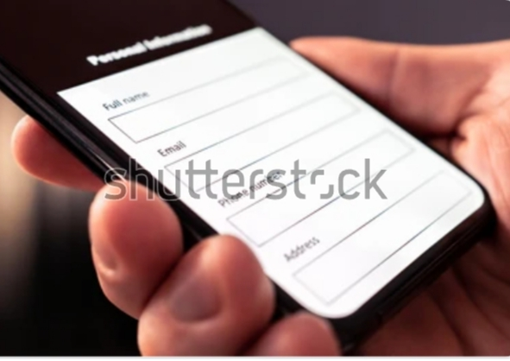

RESULTS AND SCREENSHOTS
3/21/2024 Annual Review
10

Slide 11
CONCLUSION
Highlights of your project
Final summary
Benefits to society
11

